Slide 2
Molecular Biology Biol 480
Lecture 29 April 10th , 2019

Slide 3
Announcements/Assignments

Slide 4
Where were we?...Gene expression regulation
LAC operon:
Describe its positive regulation
Describe its negative regulation.
How do glucose levels affect transcription of the lac structural genes? (Be specific)
How do lactose levels affect transcription of the lac structural genes?
What can cause constitutive expression of the lac structural genes?
Describe experiments that reveal the nature of constitutive mutants.

Slide 5
Learn the symbolic designations
I⁺O⁺Z⁺ (Y⁺ A⁺) is fully wild type.
If the mutant is predicted to have a constitutive mutation in the cis elements, it would likely be in the O region.
I⁺O^{c}Z⁺ tells us that there is a mutation in O that makes expression of lac Z constitutive.

Slide 6
As you know-- in bacteria we can do experiments to add DNA/genes and look for expression of the genes or changes in phenotype.
In nature, bacteria can transfer a special plasmid called the F’ plasmid. Any bacterium with the F’ plasmid can express other genes on it, AND pass the F’ plasmid to its progeny.
(see chapter 6 for general review)

Slide 7
The F’ plasmid does not insert itself into the bacterial chromosome---it does not become physically linked to the Lac operon structural genes.
Why do we care….?

Slide 8
What would you expect if you added the F’plasmid with a wild-type O region to a bacterium with I⁺O^{c}Z⁺ phenotype?
Would lacZ be repressed? Would it restore its inducibility? Why or Why not?

Slide 9
Let’s return to a constitutive mutant…are their other hypotheses for the defect?
Could it involve a trans element? If so, which one?
How would you designate it using our genotype symbols?

Slide 10
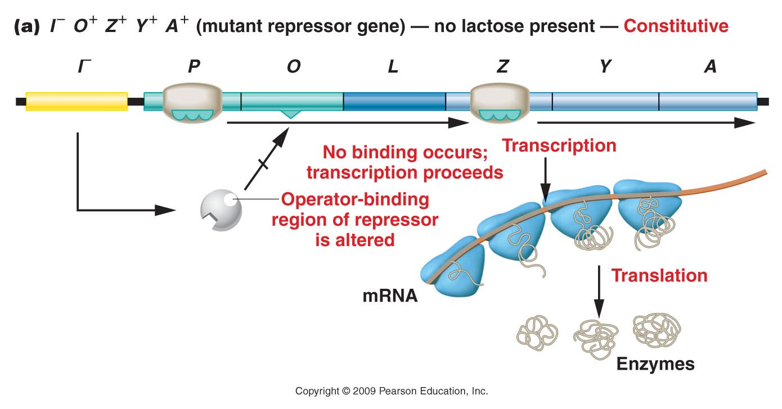
Figure 17.6a
Notes:
Figure 17-6a The response of the lac operon in the absence of lactose when a cell bears either the or the mutation.

Slide 11
Using the F’ plasmid, could you “fix” the
I⁻O⁺Z⁺ mutation?

Slide 12
What if the F’ plasmid was constructed to have a wild type I gene?

Slide 13
Mutations in trans elements can be fixed by addition of a wild type gene or by any means of getting that diffusible element into the system!

Slide 14
Summarize
Generally describe 2 types of constitutive mutants for the lac operon.
Design experiments to distinguish the type of problem that makes each mutant constitutive.
Explain the outcome of your experiements.

Slide 15
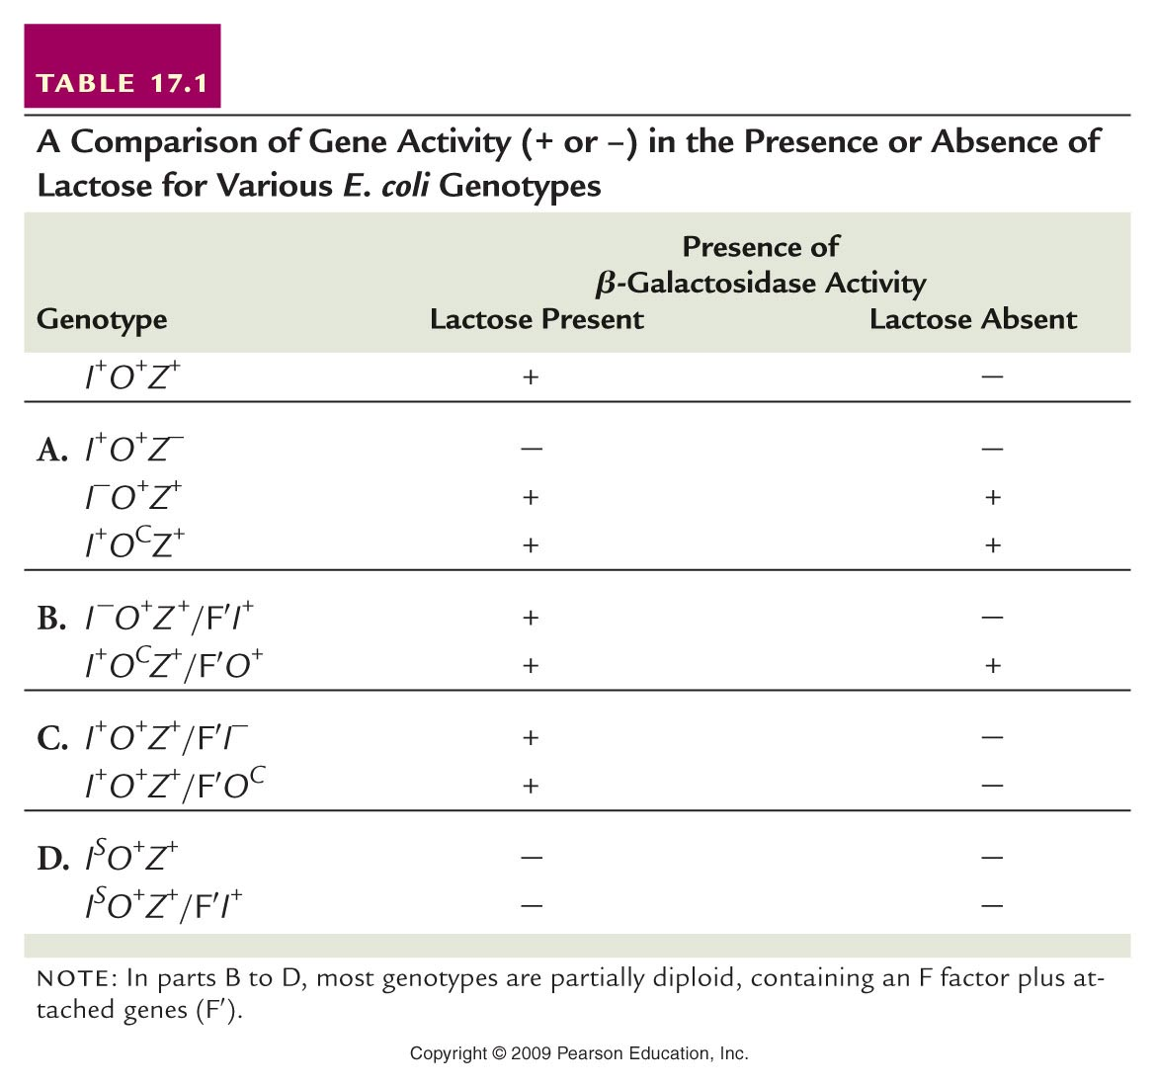
Read more! Dissect table 16.1

Slide 16
Spend time on this. Quiz yourself or class mates. Practice.
Explain the 2 experiments shown in part C—in detail. What are they trying to do?
Why does neither experiment create a constitutive mutant?

Slide 17
Let’s examine another operon, but consider an operon needed in a biosynthetic pathway.
Anabolism…the process of making something. In this case, we would think of an operon encoding biosynthetic enzymes. For example, synthesis of the amino acid tryptophan requires a set of enzymes encoded in an operon---the trp operon.

Slide 18
Let’s approach this logically.
Would you guess that this operon is generally repressed and is inducible….OR….that it is generally transcribed and is repressible?
(How generally needed is trp (or any of the amino acids?)
(In comparison…how generally needed are the lactose catabolizing enzymes?)

Slide 19
Trp Operon
The general system…It looks similar to the lac operon.
Find the structural genes
Find the regulatory (cis) elements
Find the repressor gene

Slide 20
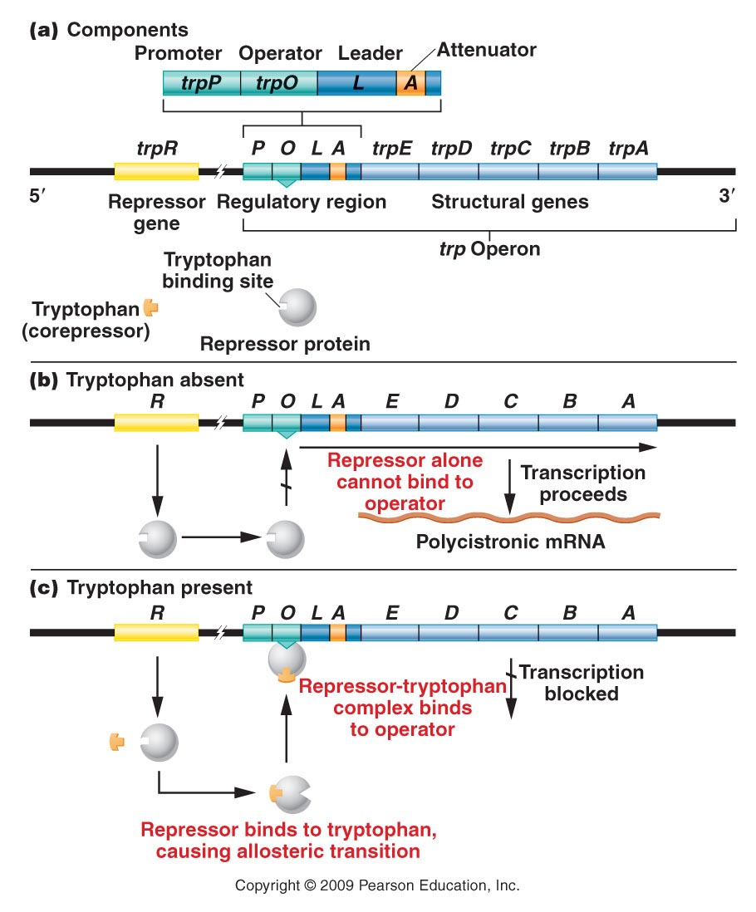
Figure 17.12
Notes:
Figure 17-12 (a) The components involved in the regulation of the tryptophan operon. (b) Regulatory conditions are depicted that involve either activation or (c) repression of the structural genes. In the absence of tryptophan, an inactive repressor is made that cannot bind to the operator (O), thus allowing transcription to proceed. In the presence of tryptophan, it binds to the repressor, causing an allosteric transition to occur. This complex binds to the operator region, leading to repression of the operon.

Slide 21
The trp synthesizing enzymes are generally transcribed in bacteria…UNLESS there is lots of trp already available. In this case, Trp acts as a co-repressor, combining with the trp protein repressor to block transcription.
Figure 17.12
Notes:
Figure 17-12 (a) The components involved in the regulation of the tryptophan operon. (b) Regulatory conditions are depicted that involve either activation or (c) repression of the structural genes. In the absence of tryptophan, an inactive repressor is made that cannot bind to the operator (O), thus allowing transcription to proceed. In the presence of tryptophan, it binds to the repressor, causing an allosteric transition to occur. This complex binds to the operator region, leading to repression of the operon.

Slide 22
This repression is really just like lac repression, except that the repressor needs the co-repressor (Trp amino acid) to bind the operator.
Be sure to study this system –compare and contrast with the lac operon.

Slide 23
This operon also has an amazing, regulation system, called attenuation. Attenuation is a way of responding to changing levels of trp in the bacterium. When trp is not really abundant trp attenuation allows the trp biosynthetic enzymes to be made a some level.
It’s complex and relies on co-translational transcription.

Slide 24
Recall….bacteria begin translation before transcription of the mRNA transcript is complete.
Ribosomes can jump on and begin decoding the mRNA codons and building the protein.
RNA polymerase continues to transcribe the gene.

Slide 26
Translation speed/progression is affected by the availability of each amino acid encoded by the mRNA.
The Trp operon has a leader sequence, that gets transcribed and is the first to get translated.
The mRNA of the leader has 2 consecutive Trp codons!

Slide 27
If sufficient Trp is present in the bacterium, the ribosomes zip through this region of the mRNA.
If Trp is at low levels in the bacterium, the ribosomes stall this region of the mRNA.

Slide 28
Note the mRNA sequence labeled 1, 2,3, 4—If you look closely the regions show inverted/reverse complementarity.
Given the chance 1 and 2, 2 and 3, and 3 and 4 could form double strands—RNA structure you’ve seen before—stem loops

